Slide 1

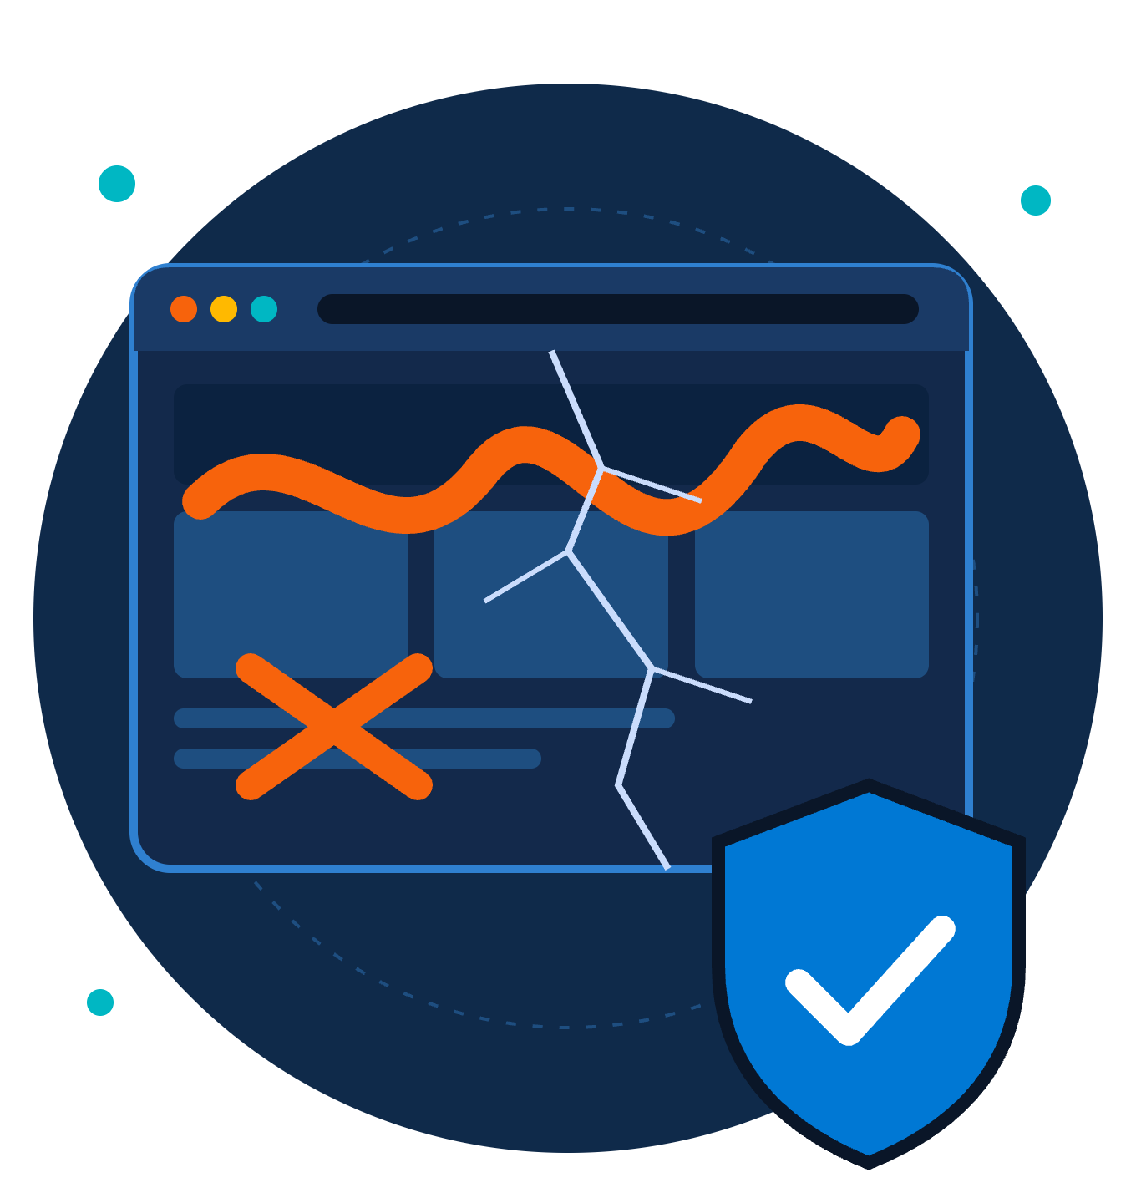
Web Defacement Awareness
ZNEXORA TECH | SECURITY BRIEFING
Protecting our website, our reputation and our visitors.
Presented by: ZNexora Tech · [Presenter] · [Date]
Notes:
[0:00 – 0:40] Good [morning/afternoon], everyone, and thank you for joining. I'm [Presenter] from ZNexora Tech. Today's topic is web defacement: when attackers break into a website and change what visitors see. Our website is often the first thing customers, partners and the public see of us, so when it's defaced, everyone notices. In the next ten minutes, I'll cover what web defacement is, why it matters, how attackers get in, how to spot it, and what each of us should do to prevent it and respond to it.

Slide 2
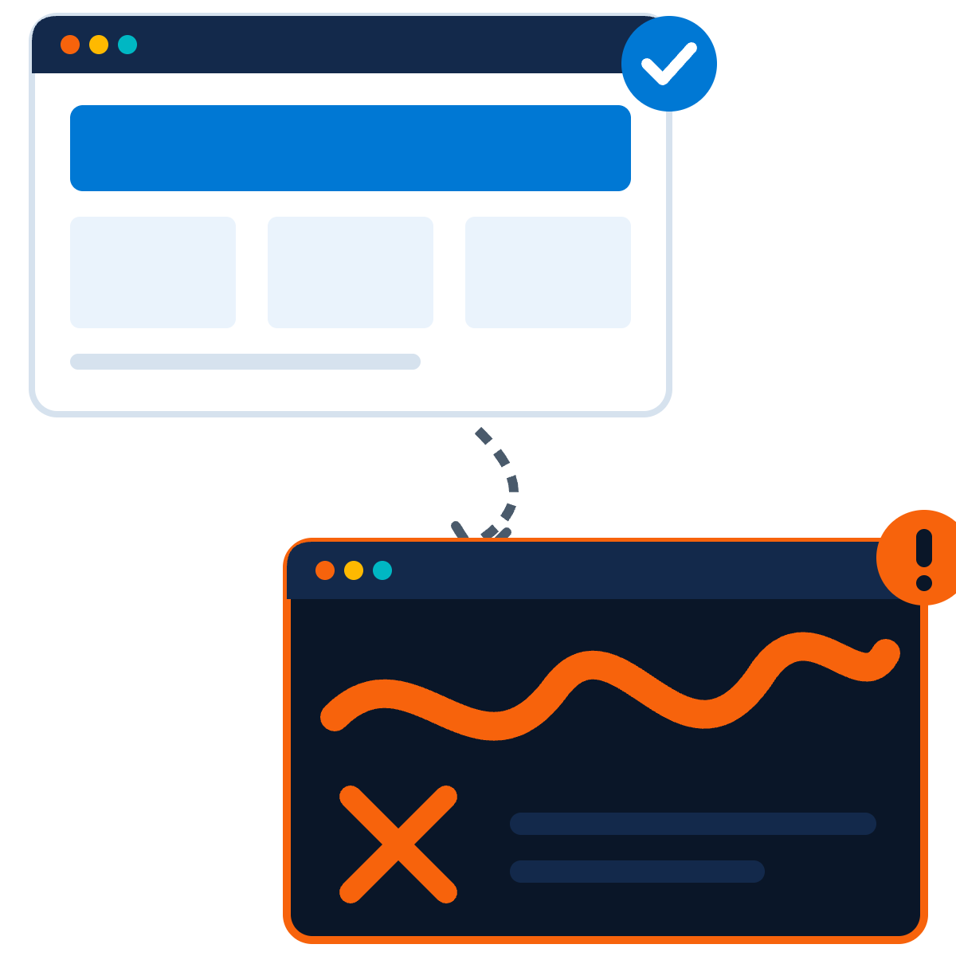
What is web defacement?
01 · UNDERSTANDING THE THREAT
An attack where someone gains access to a website and changes what visitors see.
Pages may be replaced with messages, images or political slogans, or quietly altered with fake links and hidden code.
It is the visible symptom of a security breach.
ZNexora Tech | Web Defacement Awareness
2
Notes:
[0:40 – 1:30] So what is web defacement? It's an attack where someone gains unauthorised access to a website and changes what visitors see. Sometimes it's obvious: the homepage is replaced with a message, an image, a political slogan, or a hacker's signature. Other times it's subtle: a few links are changed to point to scam sites, or hidden code is added that infects visitors' devices. The image shows a normal page on top, and the same page after a defacement below. The key point is this: defacement is the visible symptom of a security breach. If someone could change our website, they had access to our systems, and that's what we need to worry about most.

Slide 3

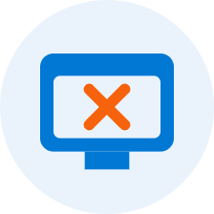

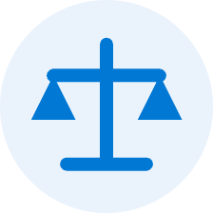
Why web defacement matters
02 · THE BUSINESS IMPACT
Reputation and trust
Service disruption
A deeper breach
Legal exposure
The site may need to go offline while we investigate and recover.
Attackers may also have stolen data or planted malware.
Possible regulatory reporting duties if personal data is affected.
Customers and partners lose confidence in our security.
ZNexora Tech | Web Defacement Awareness
3
Notes:
[1:30 – 2:30] Why does web defacement matter? First, reputation and trust. Our website is our public face. When it's defaced, customers, partners and the media see it immediately, and they start asking whether we can protect their information. Second, service disruption. We may need to take the site offline while we investigate and clean it up, which affects anyone relying on it. Third, and most importantly, it's often a sign of a deeper breach. The attacker who changed the homepage may also have stolen data, created hidden accounts, or planted malware that infects visitors. And fourth, legal exposure. If personal data is involved, we may have regulatory reporting obligations, and potential penalties. So a defacement is never just a cosmetic problem.

Slide 4




Who defaces websites, and why
03 · KNOW YOUR ADVERSARY
Hacktivists
Opportunists
Cybercriminals
Spread political or social messages to a wide audience.
Scan the internet for easy targets, often for bragging rights.
Hide malware, scam pages or spam links on trusted sites.
Most attacks are automated and opportunistic: no website is too small to be a target.
ZNexora Tech | Web Defacement Awareness
4
Notes:
[2:30 – 3:15] Who defaces websites, and why? There are three main groups. Hacktivists want to spread a political or social message, and a defaced website gives them a large, public audience. Opportunists scan the internet looking for any site with a known weakness, often just to show off or build a reputation in hacker communities. And cybercriminals often don't want you to notice at all. They quietly hide malware, scam pages or spam links on a trusted site to make money. The important lesson is at the bottom of the slide: most attacks are automated and opportunistic. Attackers don't need to pick us specifically. Their tools find any vulnerable site, so no website is too small to be a target.

Slide 5






How attackers get in
04 · ATTACK VECTORS
Outdated CMS and plug-ins
Weak or stolen passwords
Injection flaws
Insecure forms or code let attackers run commands.
Known flaws in WordPress, themes or plug-ins left unpatched.
Admin logins guessed, reused, or phished from staff.
Insecure file uploads
Misconfigured servers
Third parties
Malicious files uploaded through forms or media tools.
Default settings, open admin panels, loose permissions.
Compromised hosting, DNS accounts or web agencies.
ZNexora Tech | Web Defacement Awareness
5
Notes:
[3:15 – 4:25] So how do attackers actually get in? Here are the six most common doors. One: outdated content management systems and plug-ins. Platforms like WordPress are safe when updated, but old versions and plug-ins have publicly known flaws that automated tools exploit within days. Two: weak or stolen passwords. Admin logins that are guessable, reused from another site, or stolen through phishing give attackers the keys. Three: injection flaws, where insecure forms or code let an attacker send commands to our website or database. Four: insecure file uploads, where a contact form or media tool accepts a malicious file. Five: misconfigured servers, such as default settings, exposed admin panels or overly broad permissions. And six: third parties. If our hosting provider, DNS account or web agency is compromised, our site can be too.

Slide 6






How a defacement attack unfolds
05 · ATTACK LIFECYCLE
STEP 1
STEP 2
STEP 3
STEP 4
STEP 5
Scan
Exploit
Access
Deface
Persist
Automated tools hunt for weak sites.
A flaw or stolen password is used.
Attacker gains admin control.
Pages are changed or replaced.
Backdoors left to return later.
Restoring the page is not enough: find and close the way in, or they will be back.
ZNexora Tech | Web Defacement Awareness
6
Notes:
[4:25 – 5:10] Let's look at how a typical defacement unfolds. Step one: scan. Automated tools crawl the internet looking for websites with known weaknesses. Step two: exploit. The attacker uses an unpatched flaw, or a stolen or guessed password. Step three: access. They gain administrator control of the website or the server behind it. Step four: deface. They change or replace pages, sometimes publicly, sometimes quietly. And step five, which people often forget: persist. Attackers frequently leave hidden backdoors so they can come back. That's why simply restoring the old homepage is never enough. We have to find and close the way in, or the attackers will simply return.

Slide 7
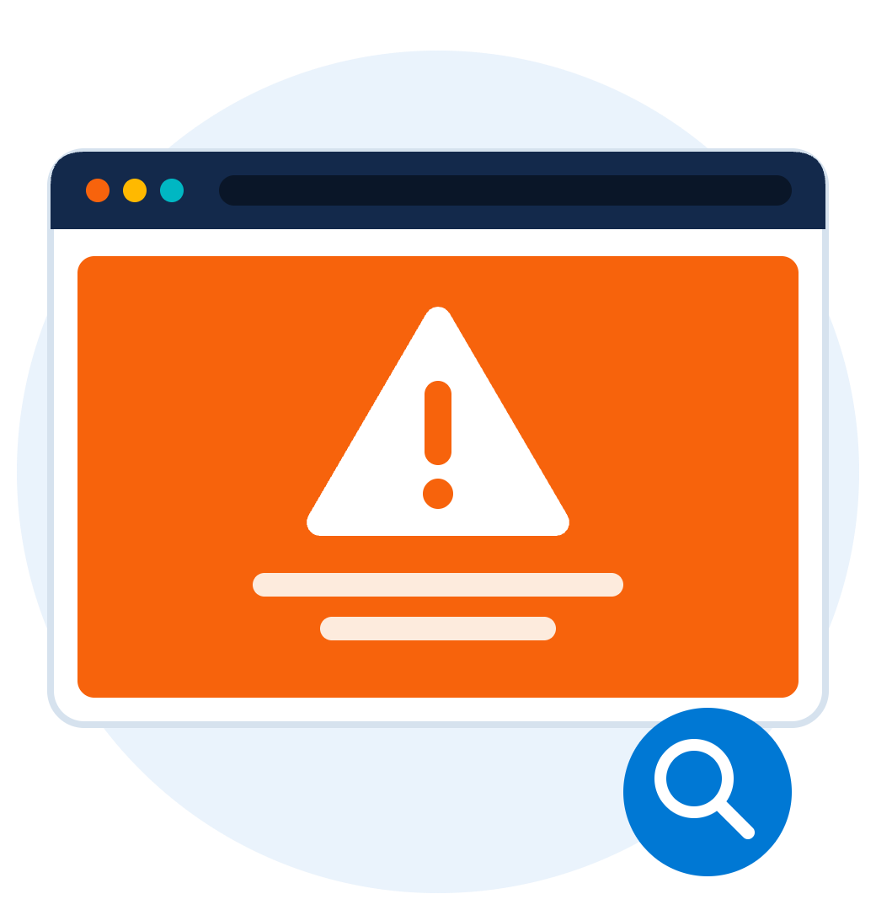

Warning signs of a defacement
06 · DETECTION
Pages, images or text changed without approval
Unknown pages, pop-ups or redirects to other sites
Browser or search engine security warnings
New admin accounts or unexpected file changes
Visitors or customers reporting something odd
ZNexora Tech | Web Defacement Awareness
7
Notes:
[5:10 – 6:00] How would we know our site has been defaced? Watch for these warning signs. Pages, images or text that have changed without anyone approving the change. Unknown pages, unexpected pop-ups, or links that redirect visitors to other websites. Browser or search engine security warnings, such as a red warning page saying the site may be harmful, or search results showing strange titles. New administrator accounts or unexpected file changes, which the web team may notice. And very often, the first sign comes from outside: a customer, partner or colleague reporting that something looks odd. Every one of us visits our website, so every one of us can be the first to notice.

Slide 8

Capture it.
Report it.
Don't touch it.
IF YOU SEE IT
Fast reporting limits the damage.
Notes:
[6:00 – 6:30] If you remember one thing today, remember this: if you see it, capture it, report it, and don't touch it. Capture it by taking a screenshot and noting the web address and time. Report it immediately to [IT / Security contact]. And don't try to fix it yourself, or share it on social media. Editing or deleting content can destroy the evidence the investigators need. Fast reporting limits the damage.

Slide 9
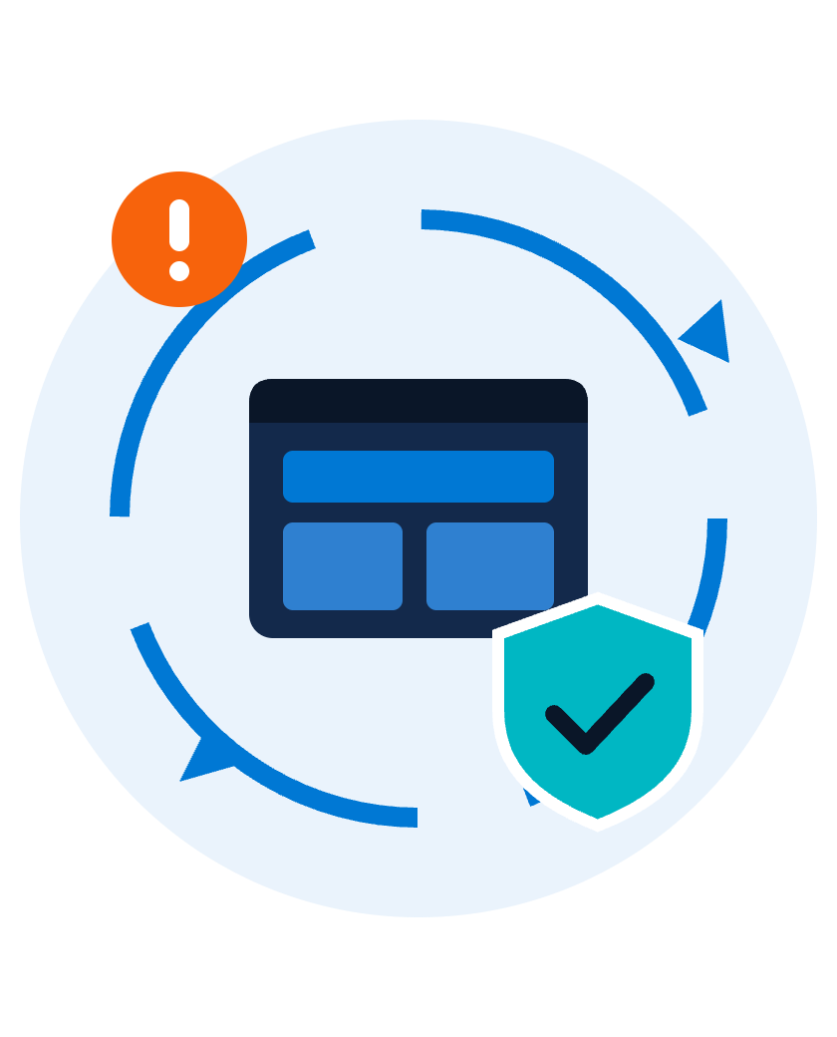
Responding to a defacement
07 · INCIDENT RESPONSE
EVERYONE
1
Report immediately to [IT / Security contact]
2
Capture evidence: screenshot, web address and time
3
Don't edit, delete or share the defaced content
WEB AND IT TEAM
4
Isolate: switch to a maintenance page
5
Fix the cause: patch, remove backdoors, reset passwords
6
Restore from a clean backup; Comms team informs users
ZNexora Tech | Web Defacement Awareness
9
Notes:
[6:30 – 7:40] Here's how we respond, and who does what. For everyone: one, report it immediately to [IT / Security contact]. Don't assume someone else already has. Two, capture evidence: take a screenshot and note the web address and the time you saw it. Three, don't edit, delete or share the defaced content, and please don't post it on social media. For the web and IT team, the next steps are: four, isolate the site, usually by switching to a maintenance page so visitors aren't exposed. Five, fix the root cause: patch the weakness, remove any backdoors, and reset all admin and hosting passwords. And six, restore the site from a clean, verified backup. In parallel, our Communications team handles any messages to customers or the media, so we speak with one clear voice.

Slide 10






Six controls that prevent defacement
08 · PREVENTION
Patch quickly
MFA everywhere
Least privilege
CMS, plug-ins, themes and servers.
Website, hosting, DNS and domain logins.
Only the access each person needs.
Web application firewall
Monitor changes
Tested backups
Blocks common attacks before they land.
File integrity and uptime alerts.
Offline copies we can restore fast.
ZNexora Tech | Web Defacement Awareness
10
Notes:
[7:40 – 8:40] Prevention is far cheaper than recovery. Here are six controls our web and IT teams rely on. One: patch quickly. Keep the CMS, plug-ins, themes and servers up to date, and remove anything unused. Two: multi-factor authentication everywhere that matters: the website admin panel, hosting control panel, DNS and domain registrar accounts. Three: least privilege. Each person gets only the access they need, and accounts are removed when people leave. Four: a web application firewall, which filters out common attacks like injection attempts before they reach the site. Five: monitor changes, with file integrity monitoring and uptime alerts so we know within minutes if a page changes unexpectedly. And six: tested backups, kept offline or separate, so we can restore a clean site quickly.

Slide 11




Everyone has a role
09 · SHARED RESPONSIBILITY
All staff
Content editors
Web and IT team
Report anything odd on our website
Use your own account, with MFA
Patch, monitor and review logs
Install only approved plug-ins
Remove unused accounts and plug-ins
Never share website or hosting logins
Log out on shared devices
Test backups and the response plan
Watch for phishing aimed at admins
ZNexora Tech | Web Defacement Awareness
11
Notes:
[8:40 – 9:20] Website security is a shared responsibility, and everyone has a role. All staff: report anything odd you see on our website, never share website or hosting logins, and be alert to phishing emails, because attackers often target the people who manage our site. Content editors: always use your own named account with multi-factor authentication, install only approved plug-ins, and log out when you use a shared device. And the web and IT team: keep everything patched, monitor for changes and review logs, remove unused accounts and plug-ins, and regularly test our backups and our response plan.

Slide 12




Who to contact
10 · REPORTING
IT / Security
Web team
Communications
[Extension]
[web@...]
[Contact]
Report a suspected defacement
Unexpected changes or errors
All media and customer messages
Out of hours? Call [on-call number]. Every minute online increases the damage.
ZNexora Tech | Web Defacement Awareness
12
Notes:
[9:20 – 9:40] Here's who to contact. For a suspected defacement, call IT and Security on [extension]. For unexpected changes or errors on the site, contact the web team at [web@...]. And all messages to the media or customers go through the Communications team at [contact]. Outside office hours, call [on-call number]. Every minute a defaced site stays online increases the damage, so please don't wait.

Slide 13
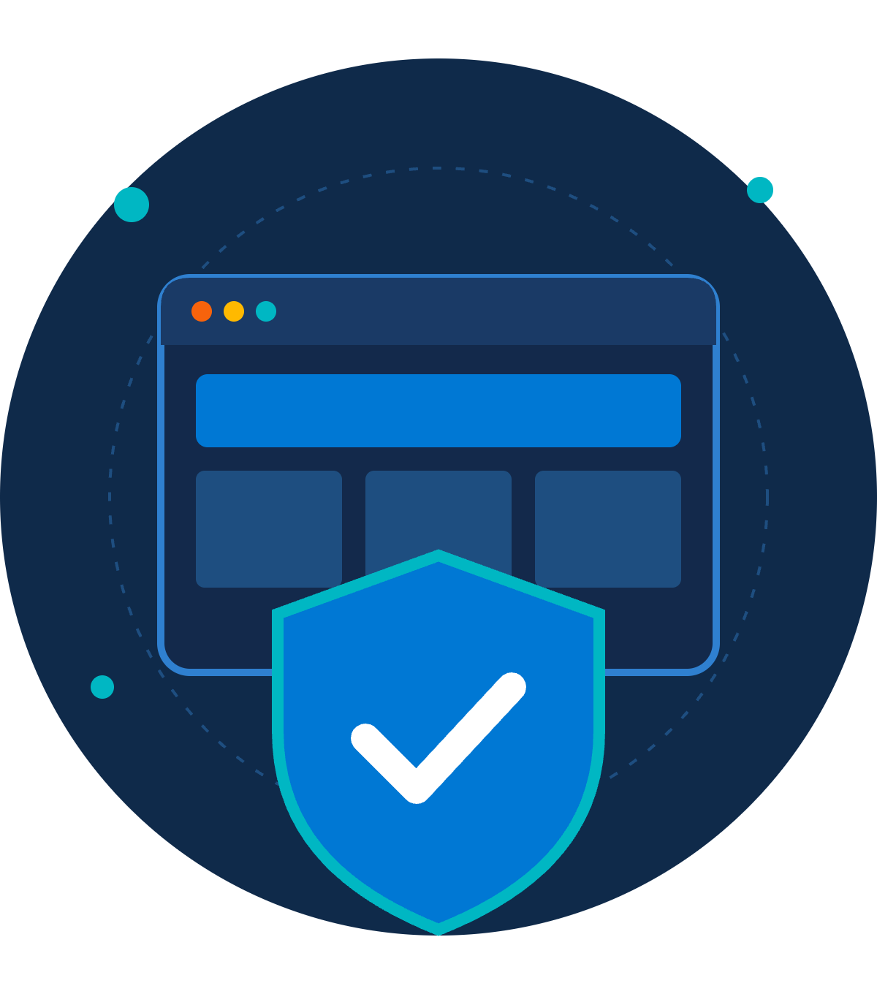
Our website is our front door.
QUESTIONS AND DISCUSSION
Let's keep it secure, together.
Thank you · Presented by ZNexora Tech
Notes:
[9:40 – 10:00] To wrap up: our website is our front door to the world. Keeping it secure protects our reputation, our data, and everyone who visits it. If you see something odd, capture it, report it, and don't touch it. Thank you for your time. I'm happy to take any questions.

